Slide 1
INTERNAL CAPSULE
Dr RESHMY K.R
Professor
Dept. of Physiology
SKHMC

Slide 2
INTERNAL CAPSULE

Slide 3
A broad compact band of both afferent and efferent nerve fibers passing to and from the brainstem to the entire cerebral cortex are seen between the thalamus and the basal ganglia.
At the upper part of the brainstem, these fibers form a compact band known as the internal capsule.

Slide 4
The internal capsule projection fibers pass to and from cerebral cortex as corona radiata.

Slide 5
Because of the wedge shape of the lentiform nucleus, as seen on horizontal section, the internal capsule is bent to form an anterior limb and a posterior limb, which are continuous with each other at the genu.

Slide 6
It is a 'V'shaped band of projection fibers
The internal capsule is divided into 5 regions:
The anterior limb is the portion between the lenticular nucleus and the head of the caudate nucleus;
The posterior limb is the portion between the lenticular nucleus and the thalamus
The genu is the portion at the junction of the above 2 parts and is adjacent to the interventricular foramen
The retrolenticular part is the portion posterior to the lenticular nucleus
The sublenticular part is the portion inferior to the lenticular nucleus

Slide 7
Fibers passing through Internal capsule
A compact bundle of fibres through which the large collectionsof fibres pass including-
• Thalamocortical fibres
• Corticothalamic fibres
• Corticopontine fibres
• Corticobulbar fibres
• Corticospinal fibres

Slide 8
The fibres project from the cerebral cortex to the various nuclei of the extrapyramidal system (e.g., the putamen and caudate nucleus).
It is a continuous sheet of fibres that forms the medial boundary of the lenticular nucleus.
It continues around posteriorly and inferiorly to partially envelop this nucleus.
Inferiorly, many of the fibres of the internal capsule funnel into the cerebral peduncles.

Slide 9
Superiorly, the fibres fan out into the corona radiata.
Here, they travel in the cerebral white matter to reach their cortical origins or destinations.

Slide 10
Anterior limb
Site: between head of Caudate nucleus and Lentiform nucleus
Contents:
1.Fibers from ant. group of thalamus to Cingulate gyrus-Thalamocortical fibers
2.Fibers from medial nuclear group of thalamus to prefrontal cortex- Thalamocortical fibers
3.Frontopontine fibers

Slide 11
Anterior limb contains:
Frontopontine from the frontal lobe to the pontine nuclei through medial part of cerebral peduncle & then cross to cerebellum.
Thalamocortical sensory to frontal lobe.

Slide 13
Genu contains
Corticonuclear ( corticobulbar) fibers to motor nuclei of cranial nerves.

Slide 14
Posterior limb
Site:
Between Thalamus and Lentiform nucleus
Contents:
1. Corticospinal
2. Fibers from ventral posterior nucleus of Thalamus to Post central gyrus (Thalamocortical)
3. Fibers from Ventral Anterior and Ventral lateral nucleus of Thalamus to motor regions of frontal lobes
4. Temporopontine and Parietopontine fibers

Slide 15
Posterior limb contains:
Thalamocortical fibers to parietal lobe.
Corticospinal fibers to upper limb, lower limb & trunk

Slide 16
Retrolenticular part
Site:
Behind lentiform nucleus
Contents:
1. Fibers from medial geniculate body of Thalamus to Auditory cortx
2.Fibers from lateral geniculate body of Thalamus to Visual cortex
3.Parieto- temporo- and Occipito Pontine fibers

Slide 17
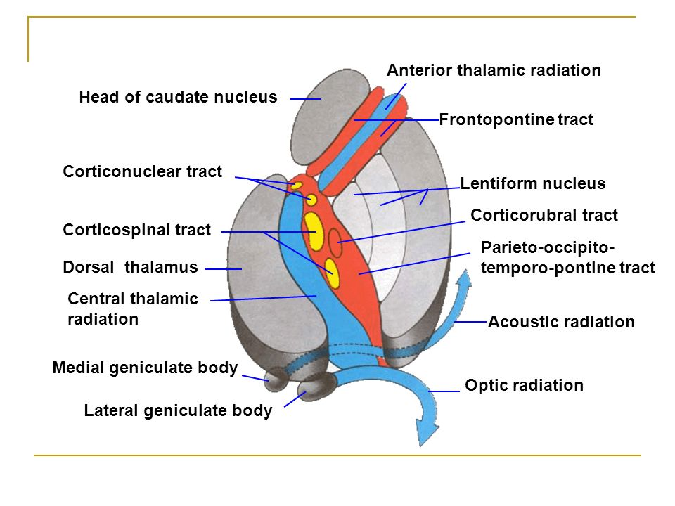
Optic radiation pass in posterior limb to visual cortex.
Auditory radiations pass in posterior limb to auditory cortex
Retrolenticular and sublenticular parts contains optic radiations and auditory radiations

Slide 18
Connections

Slide 19
Blood supply:
Lenticulostriate arteries of the middle cerebral artery.
Anterior and posterior cerebral can give branches.
Cerebrovascular accidents of the internal capsule(CVA) can lead to different neurological deficits(motor & sensory).

Slide 20
THANK YOU
References
https://in.pinterest.com/pin/72690981471593129/
https://anatomyqa.com/internal-capsule/
https://rislyonline.wordpress.com/2017/06/12/blood-supply-of-internal-capsule/

